Slide 1
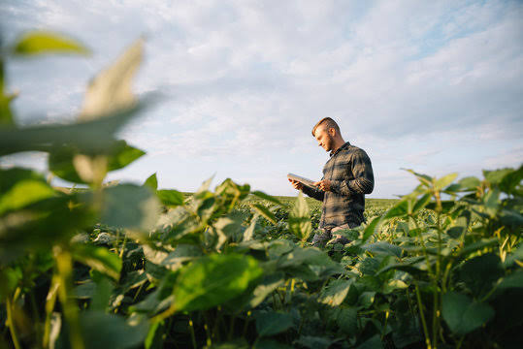

Slide 2
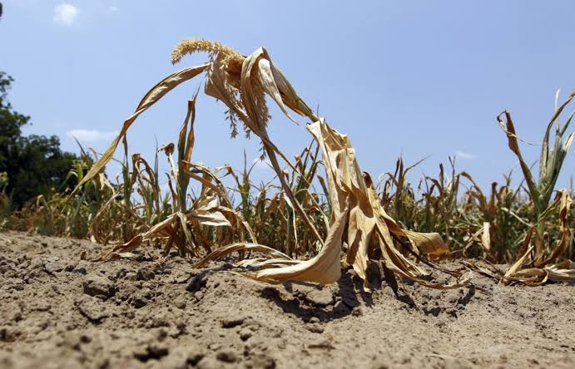

Slide 3



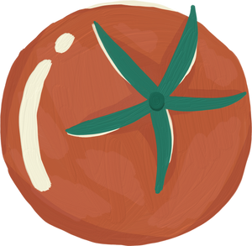
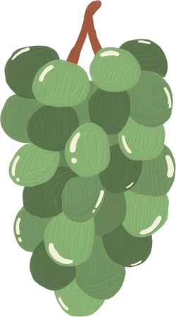
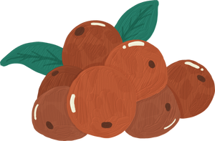

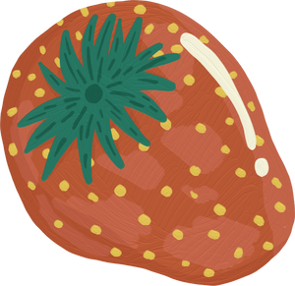
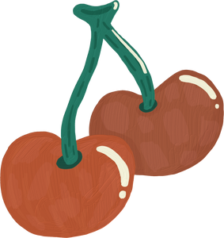
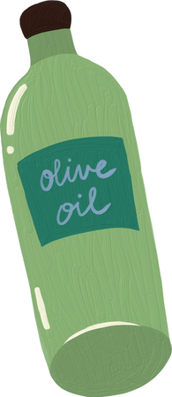
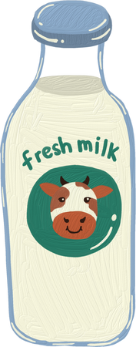
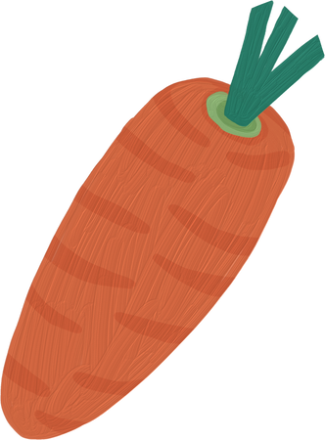
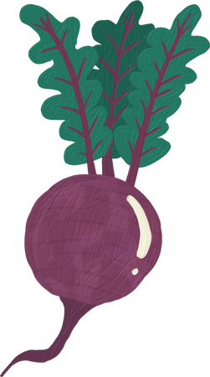


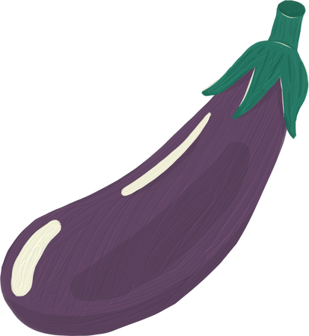
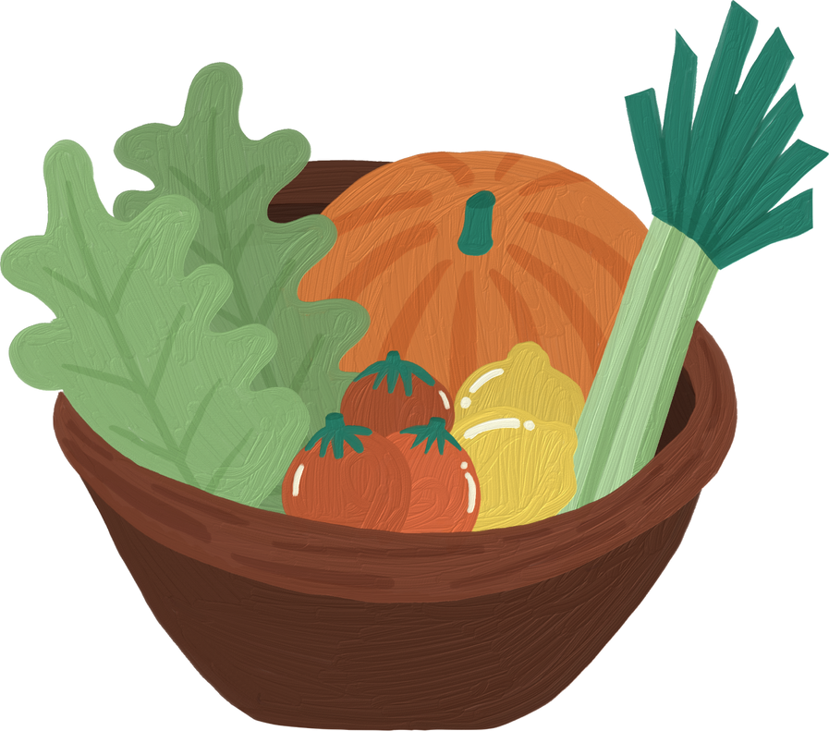
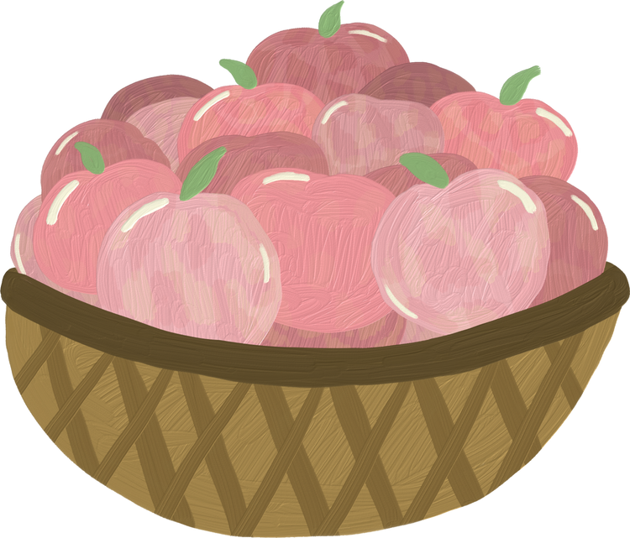
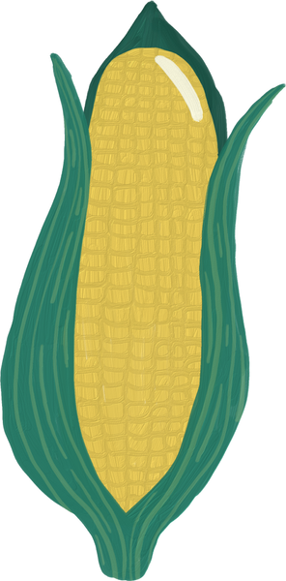

TANIBOSS!
TAANEE BⱰS
A united website for the welfare of Indonesian farmers

Slide 4
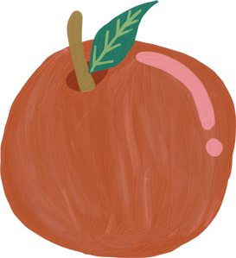

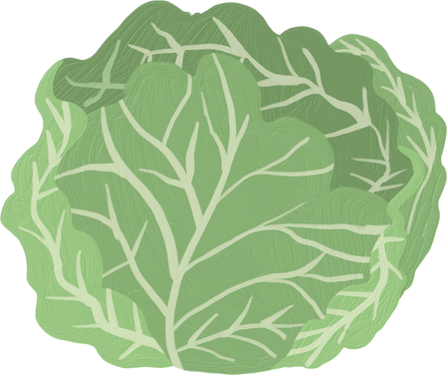
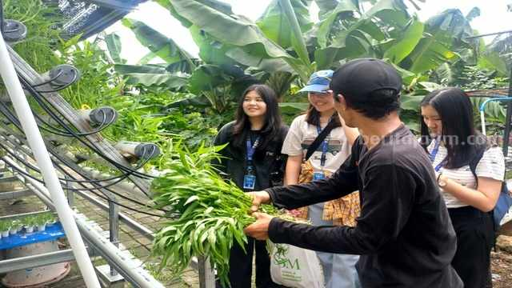

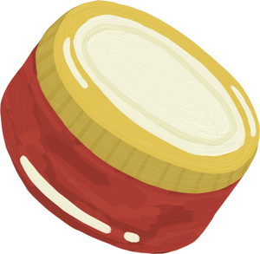

THE PROBLEM?
Some of the hydroponic spinach at Gunung Anyar Edufarm kept dying.
The farmers don’t know the right nutrients to give.
Beberapa jenis sawi hidroponik di Edufarm Gunung Anyar terus mati.
Petaninya tidak tau nutrisi apa yang sebaiknya diberi.

Slide 5
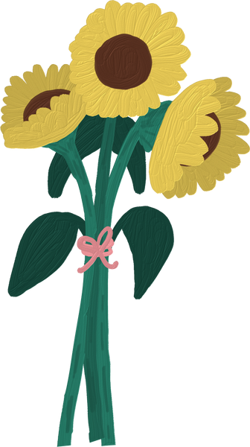

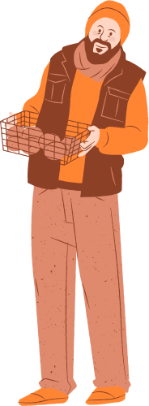


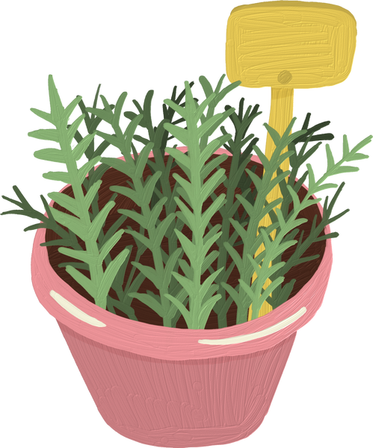
HOW MIGHT WE...
Bagaimana cara kita...
utilise machine learning to optimise hydrophonic conditions (nutrients in water, weather, sunlight) to increase the yield of spinach?
menggunakan Machine Learning untuk memaksimalkan
kondisi-kondisi tumbuhan hidroponik (nutrisi di air,
cuaca, sinar matahari) untuk meningkatkan hasil panen
tumbuhan jenis sawi?

Slide 6
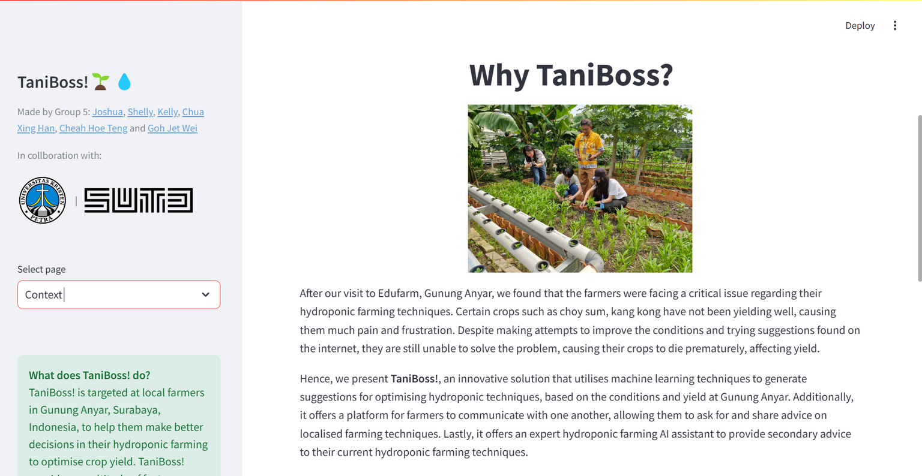

TANIBOSS!

Slide 7
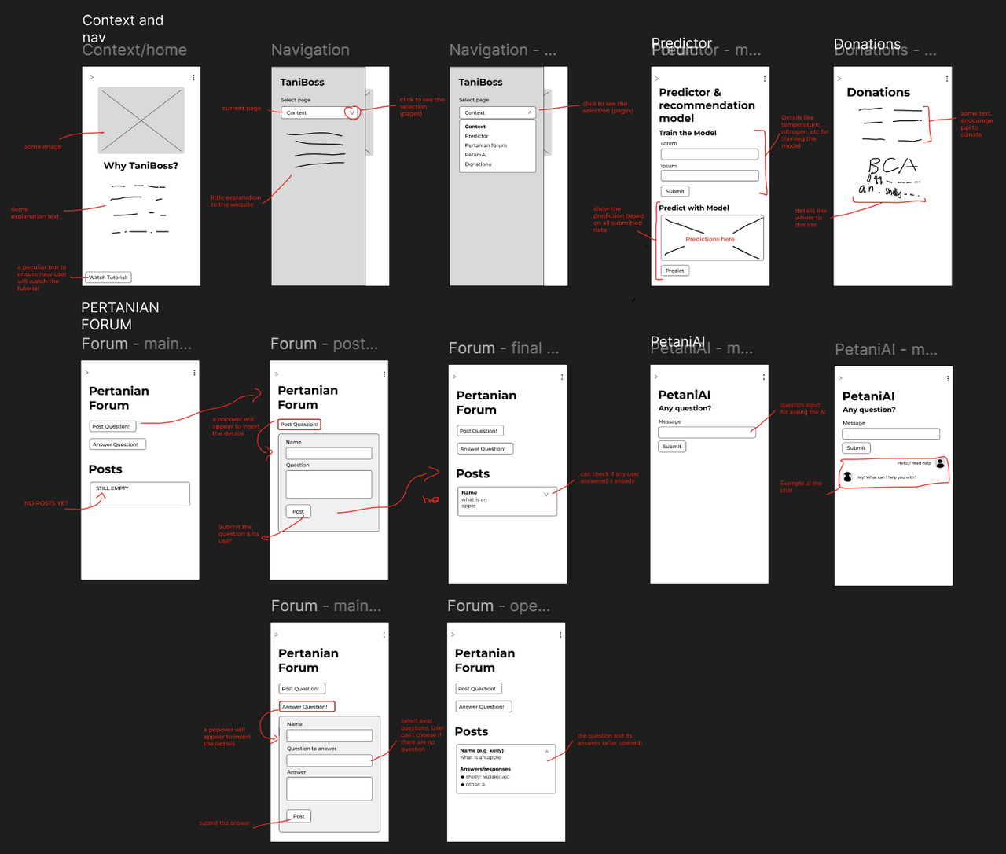
LO-FI

Slide 8
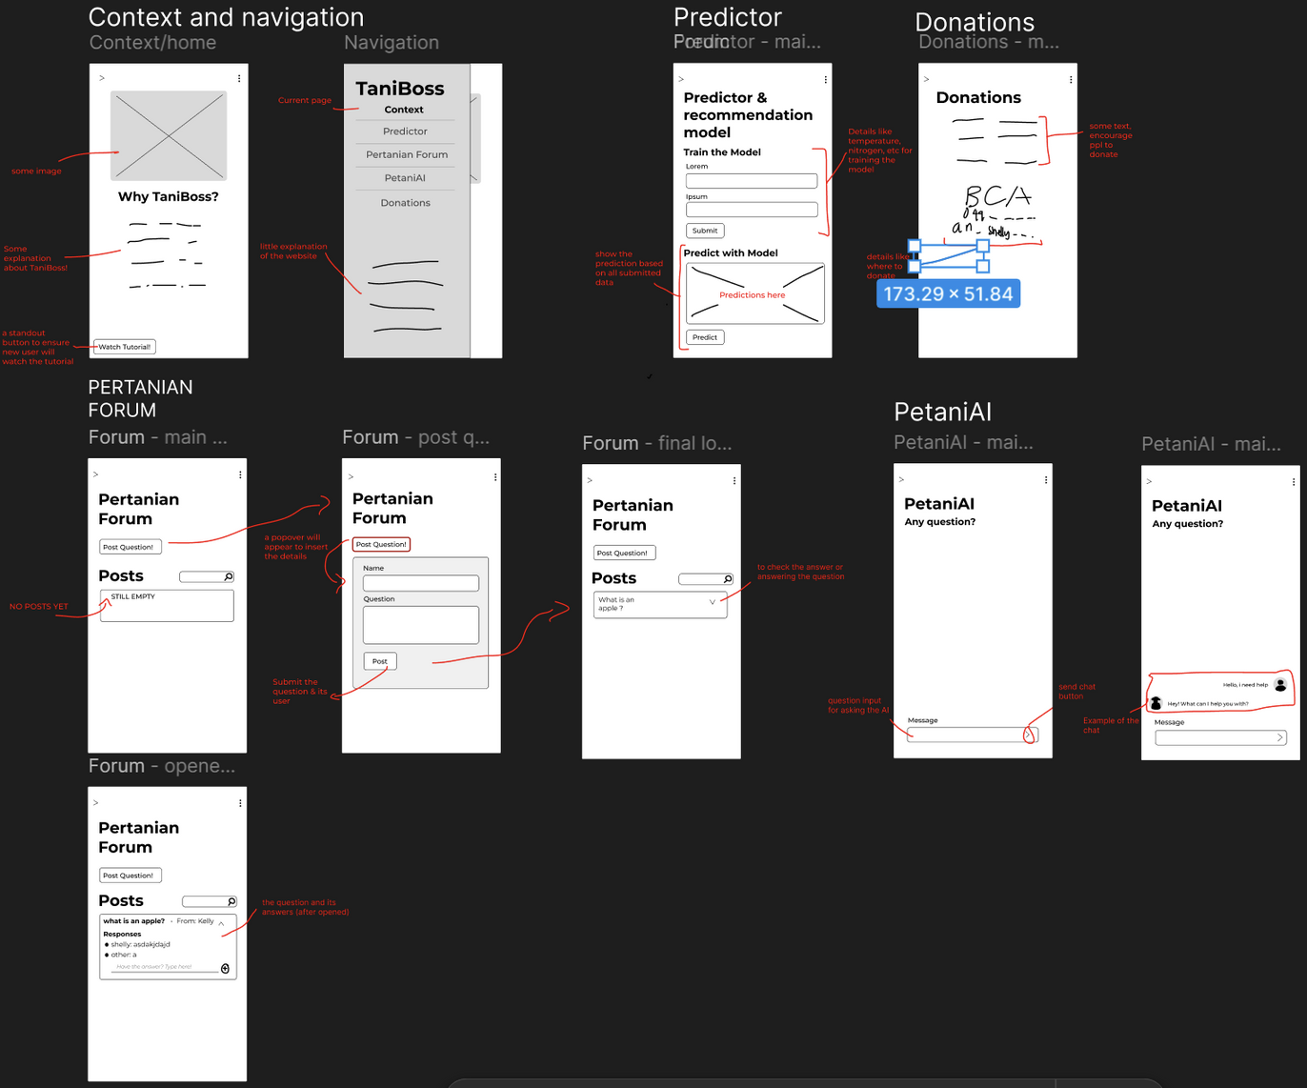
LO-FI

Slide 9
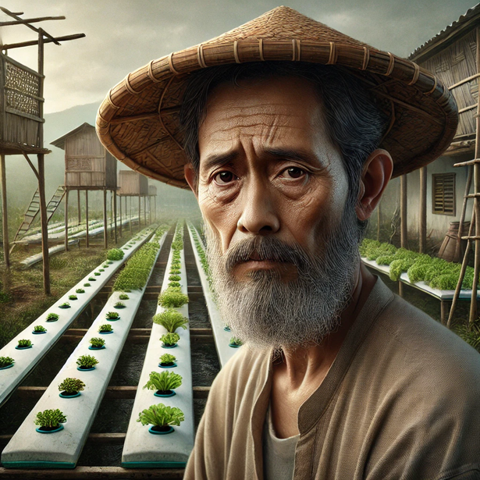
PERSONA
DEMOGRAPHICS
PAIN POINTS AND FRUSTRATIONS
Age: 48
Income: 1,400,000 IDR/month
Gender: Male
Role: Senior Farmer
Hobbies: Taking care of plants
Likes:
Taking care of his plants
Productive workers
Drinking coffee
Dislikes:
Unhealthy and wilting crops
Lack of knowledge about hydroponic farming.
Challenges in growing crops in Gunung Anyar due to unique local conditions.
General farming solutions often fail due to the region specific needs.
NEEDS AND GOALS
Requires a cost-effective and easy-to-understand solution to address low yields resulting from unoptimised farming practices for local environmental conditions.

Slide 10
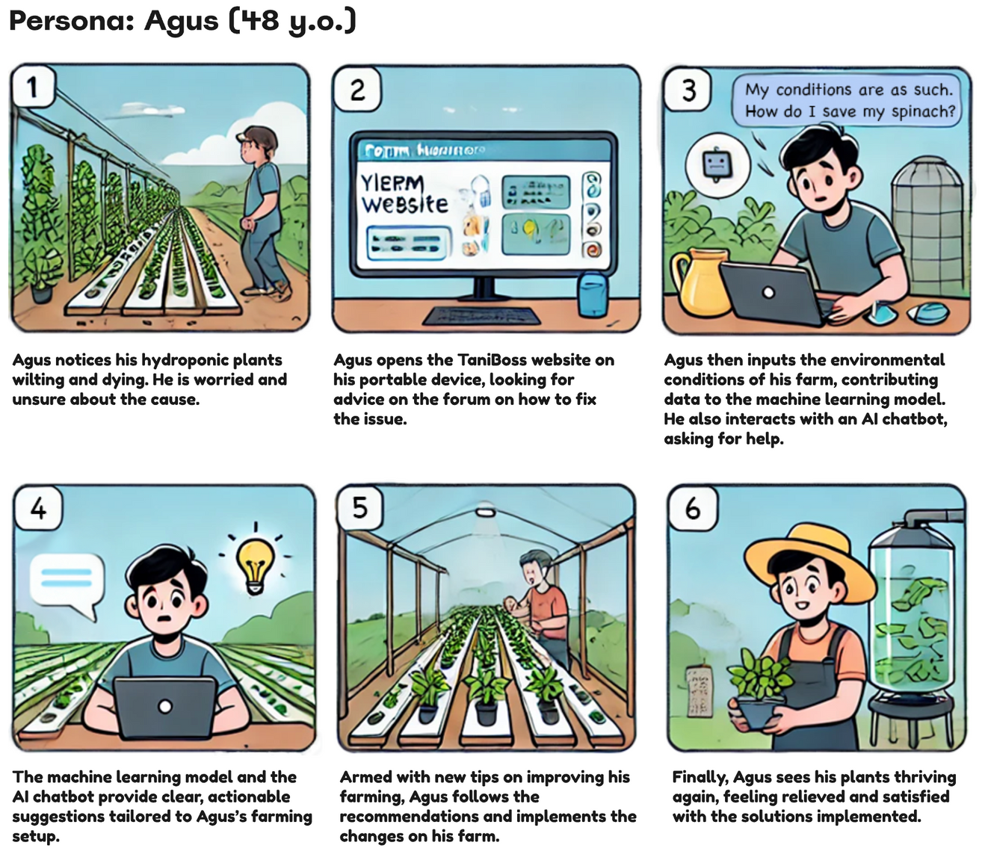
STORYBOARD

Slide 11
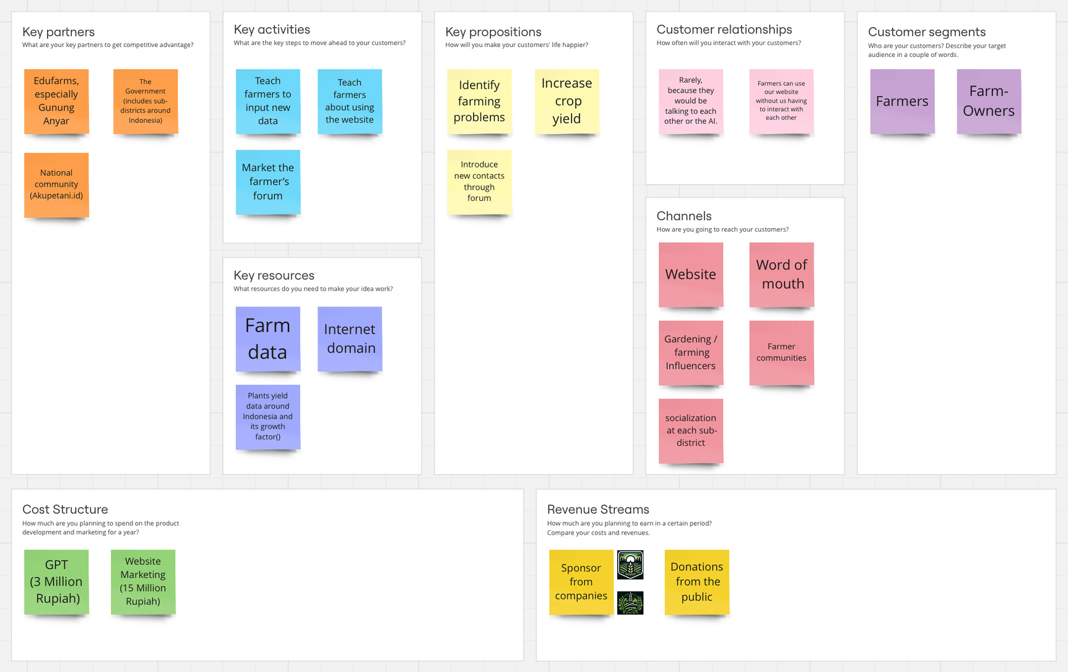
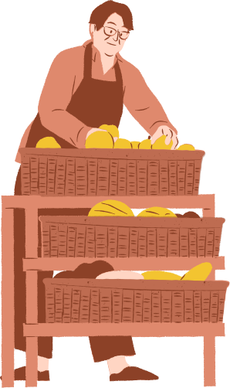
BUSINESS MODEL CANVAS

Slide 12
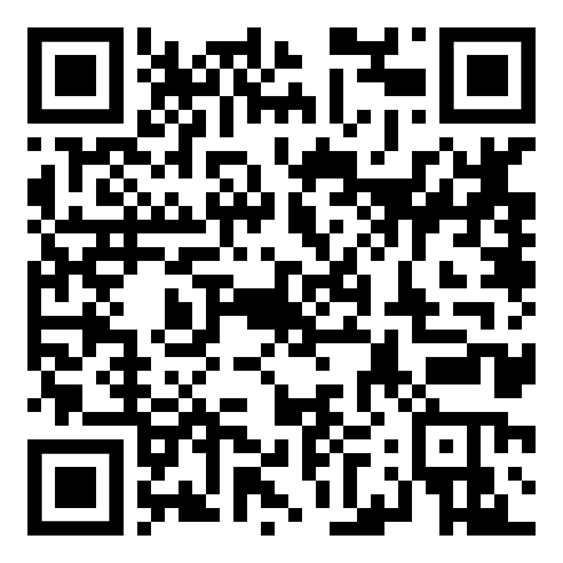
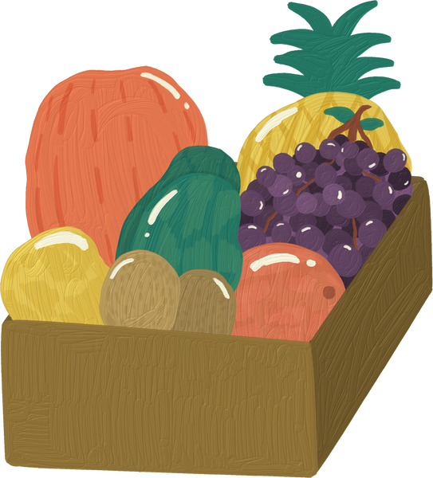
LET’S TEST IT OUT!
https://fact-farming-app-website-gbadlidje6qkb8rayevhhp.streamlit.app/

Slide 13

WHAT’S NEXT?
Apa selanjutnya?
MARKETPLACE
Why?
Reduce their dependency on donations for the website’s maintenance or other future programs by taking a percentage of the sales
Other Benefits:
Supports Indonesian farmers’ fresh produce sales
Platform for farmers to directly sell their organic, fresh produce to customers.
Sebuah platform untuk menjual produk segar para petani ke masyarakat.
EXPANDING AWARENESS
Why?
Ensuring the website can reach the right audience and be used well for Indonesia’s agriculture
Other Benefits:
Collects more data to further help other farmers’ crops
Through partnering with communities and working with influencers.
Bekerjasama dengan komunitas dan Influencer.

Slide 14
WHAT’S NEXT?
Apa selanjutnya?
ARTICLES
Why?
To give new insights to our farmers daily to further improve their work
Other Benefits:
Potentially improving our farmer’s knowledge. A.k.a. make our farmers smarter
Reliable up-to-date news about the biology, economy, or politics of crops.
Berita terkini yang terpercaya tentang biologi, ekonomi, dan politik tanaman.
VARIANCE IN NUMBERS OF PREDICTORS
Why?
So farmers would still be able to use the predictor without knowing really well about their crops conditions
Allows farmers to customise the no. of predictors used to tailor the model according to their specific needs.
Memperbolehkan petani kustomisasi input yang harus dimasukkan untuk prediktor.

Slide 15

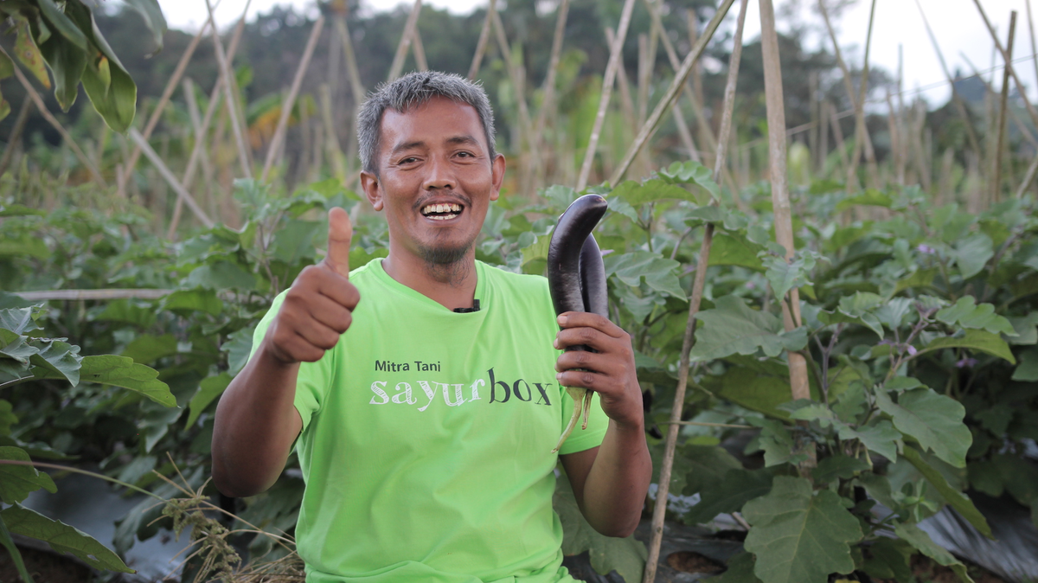
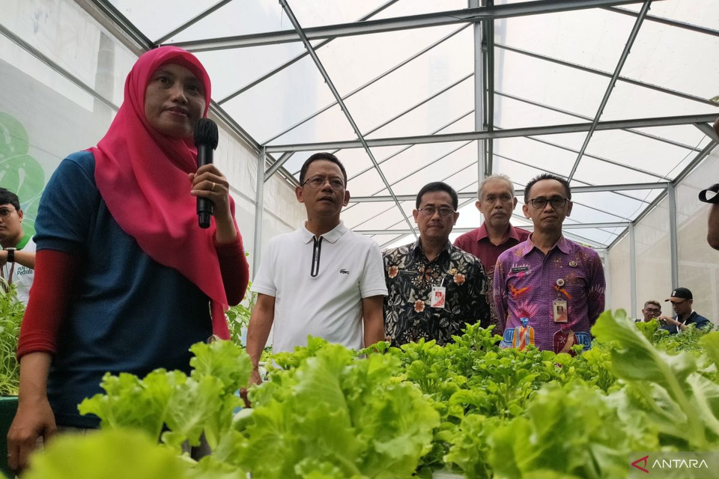
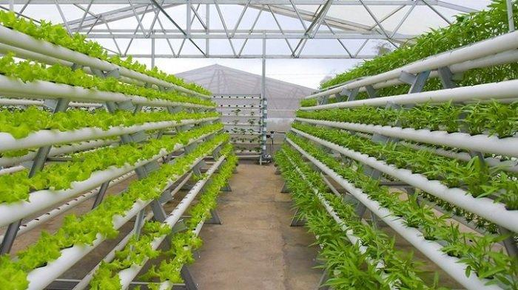
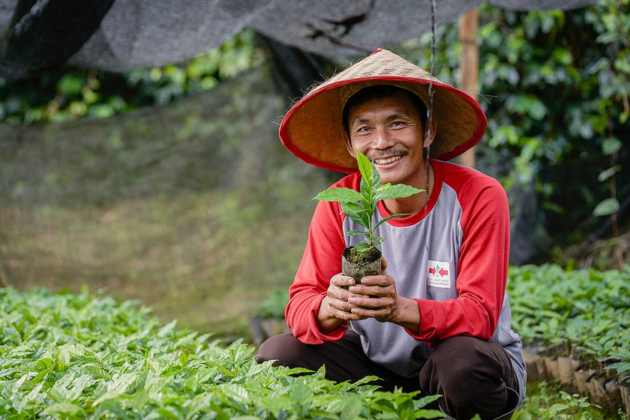
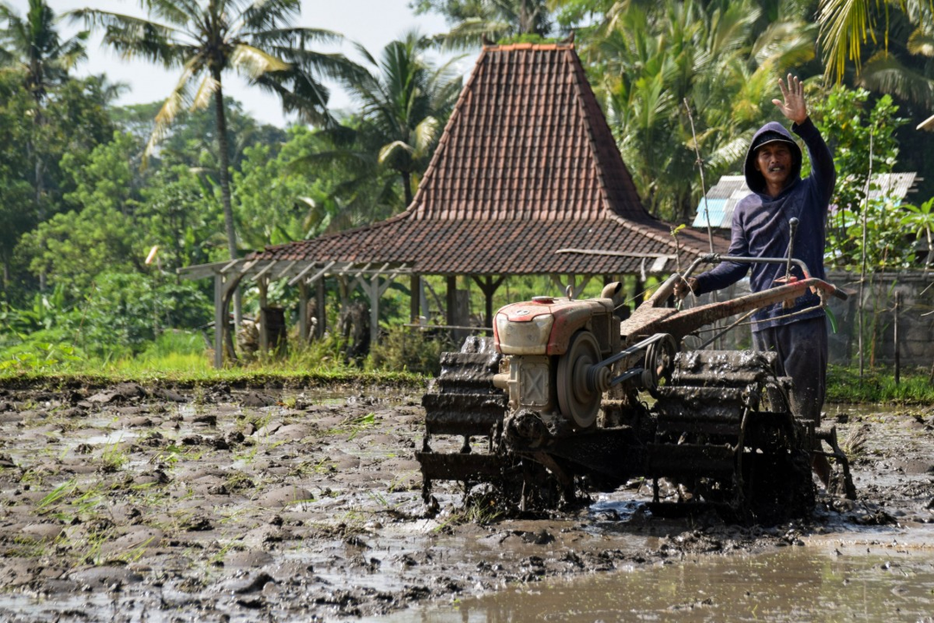
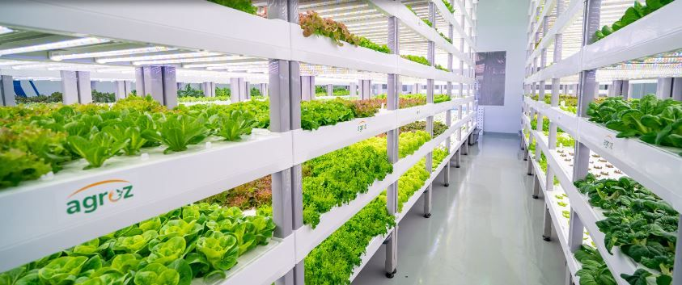
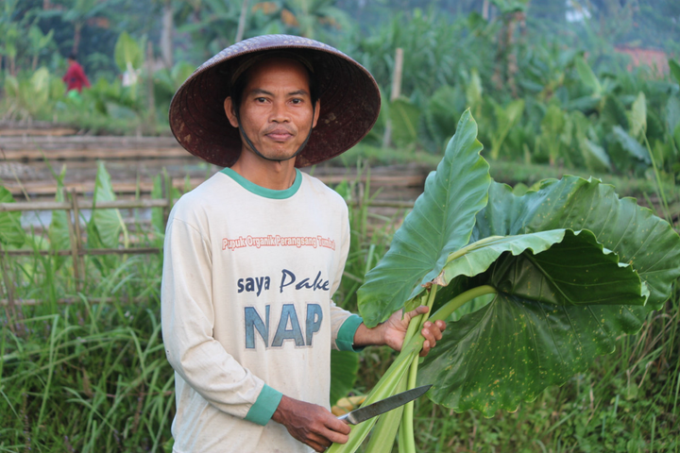
Together, building a greater agriculture for Indonesia with...
TANIBOSS!

